Slide 1
Design of RNA-Seq and Result Interpretation (I)
Sanzhen Liu
Department of Plant Pathology
Kansas State University
@K-State IGF RNA-Seq Workshop (PLPTH885)
6/7/2018

Slide 2
Schedule (6/7)
9:30 – 10:50 Lecture I (RNA-Seq)
11:00 – 12:00 Lab I (R introduction)
Lunch break
1:00 – 1:30 Lecture II (DE analysis)
1:45 – 3:30 Lab II (DE analysis)

Slide 3
Outline
Review of RNA-Seq procedure
Design of DE experiments and results
Experimental design
Multiple test correction
New technologies
Other applications

Slide 4
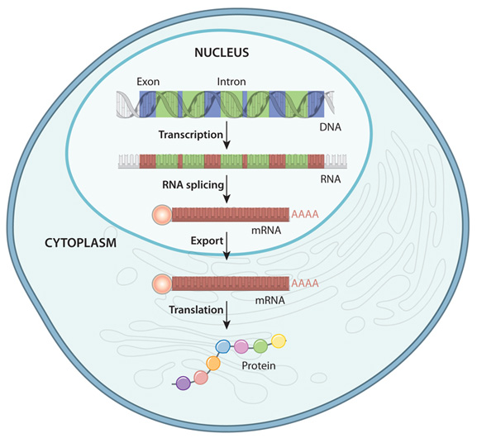

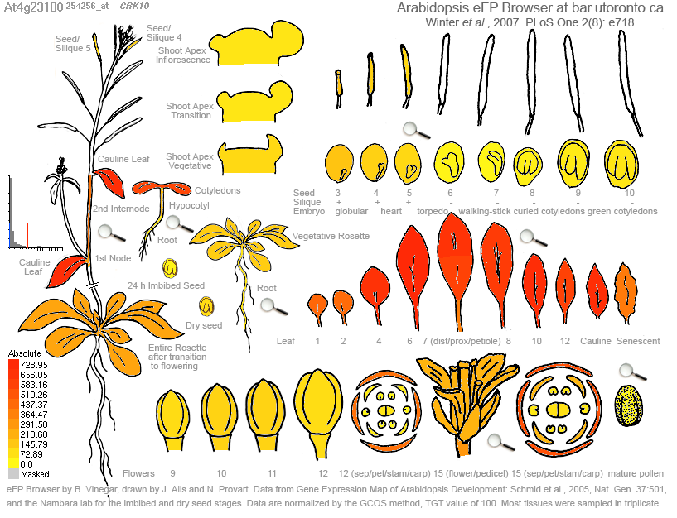
Gene expression
Transcripts
cragenomica.es
Response to biotic stress
DNA to protein in eukaryote
Expression profiles in different tissues
nature.com/scitable/topicpage/gene-expression-14121669

Slide 5
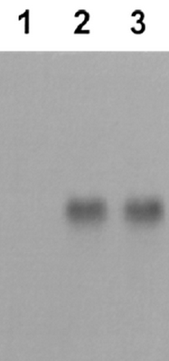
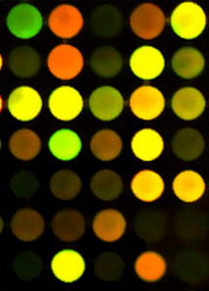
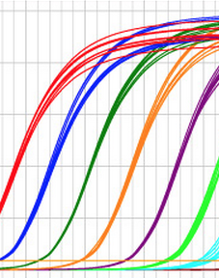
Approaches for quantification of gene expression
How can we measure the accumulative level of transcripts of a given gene in millions/billions of transcripts?
Northern
blot
qRT-PCR
microarray
RNA-Seq
biochemj.org
quantabio.com
csmbio.csm.jmu.edu

Slide 6
Rationale of RNA-Seq for differential expression (DE)
genomic DNA
10 millions of transcripts in each
exon
intron
gene of interest
100
5
mRNA/transcript
sequence 1,000 transcripts
Essentially, RNA-Seq is designed to measure mRNA accumulation levels of genes by
1) recognizing mRNA based on sequences
2) quantifying mRNA of each gene
0 0
sequence 1 million transcripts
10 1
Millions times of sampling to quantify each component (transcript) in tissue samples.
Differential expression (DE)?

Slide 7

Race of sequencing technologies
1970’s Sanger sequencing
Roche 454
eetimes.com
Illumina
www.genome.gov
Data source: genome.gov/sequencingcosts

Slide 8
RNA-Seq procedure for DE analysis
total RNA
mRNA
RNA to sequencing reads
1
DNA library
sequencing
reads
reads to read counts per gene
c
2
alignment
read counts
read counts to significant genes
statistical test
3
q-values
significance

Slide 9
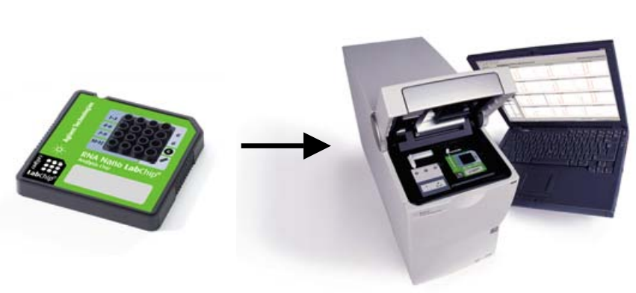
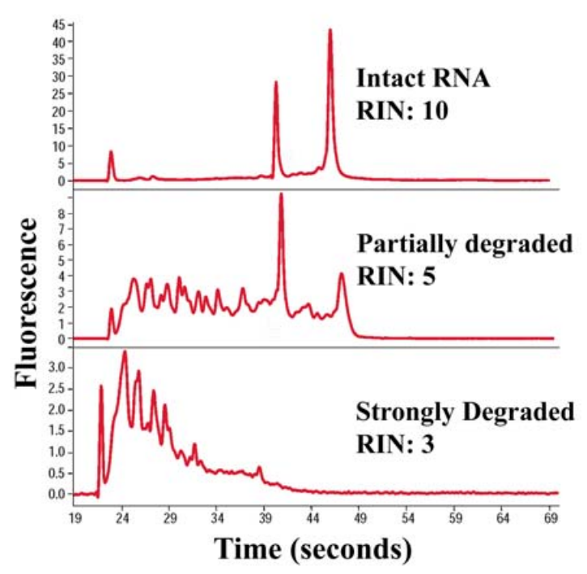
total RNA
total RNA
mRNA
DNA library
RIN: RNA Integrity Number
sequencing
a value from 1 to 10, with 10 being the least degraded.
reads
alignment
read counts
statistical test
q-values
significance
http://www.agilent.com/about/newsroom/lsca/background/rna_integrity.pdf

Slide 10
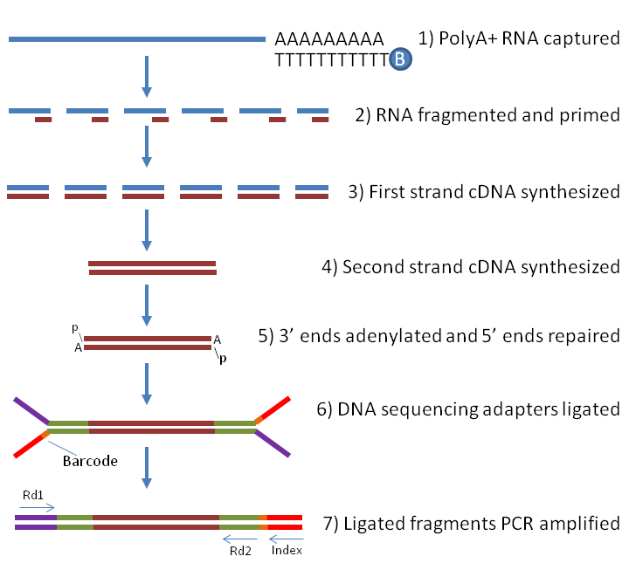
RNA to sequencing reads
total RNA
mRNA
DNA library
sequencing
reads
alignment
read counts
statistical test
q-values
significance
labome.com/method/RNA-seq-Using-Next-Generation-Sequencing.html

Slide 11
Reads to read counts per gene
total RNA
exon
intron
mRNA
DNA library
sequencing
1. reads
reads
2. alignment to the reference genome
split read
alignment
Reference genome
read counts
An intron-aware aligner is important for RNA-Seq reads alignment (e.g., Tophat, STAR, and GSNAP)
statistical test
3. read counts
q-values
N = 19 if all reads can be confidently mapped to the reference genome
significance

Slide 12
Alignment issues
Repeats
Sequencing errors
Polymorphisms (reference and sequenced sample)
Quality of reference genomes (mis-assembly and incomplete genome)
reads
Ref
Notes:
reads are relatively short (30 to 150 bp), making it hard to unambiguously assign them to a specific location in the genome, especially in the presence of sequencing errors and repeat sequences.

Slide 13
Solutions to mitigate problems
Unique mapped reads
reads
✗
✓
Ref
Longer reads or Paired-end reads
reads
…
Ref
Tolerance of mismatches or gaps for each alignment
Better reference genome

Slide 14
Count matrix Read counts (Raw) per gene
total RNA
mRNA
DNA library
sequencing
Gene | sample 1
gene 1 | 6,075
gene 2 | 295
... | ...
sample 2 | sample 3
5,934 | 3,370
377 | 169
... | ...
reads
alignment
read counts
statistical test
q-values
significance

Slide 15

Read counts to significant genes
total RNA
mRNA
T
2x2 Table for Gene 1
DNA library
Control 1
TRT 1 (salt)
 | Gene 1 | Others
Control 1 | C1 | N1 – C1
TRT 1 | T1 | N2 – T1
sequencing
RNA
Library
Sequencing
reads
Fisher’s Exact Test or χ² test on Gene 1
A p-value for Gene 1
Repeat on all the genes
p-values
Multiple testing correction
q-values
Declaration of significance
a significant gene set
alignment
N1 reads
N2 reads
Trimming
Alignment
Read counting per gene
read counts
statistical test
Gene | Control 1 | TRT 1
1 | C1 | T1
2 | C2 | T2
…
Sum | N1 | N2
q-values
significance

Slide 16
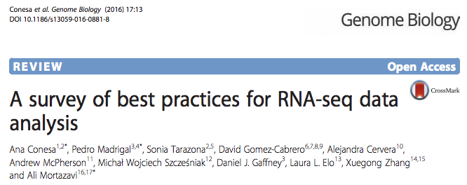
Statistical test for differential expression
Statistical test to discover differential expression (DE)
Count data: Generalized Linear Model (GLM) to deal with count data
e.g., Poisson GLM could handle count data but overdispersion exits
Dispersion issue: Using negative binomial GLM to incorporate dispersion into the model
edgeR (Robinson and Smyth, 2007), DESeq (Anders and Huber, 2010), NBPSeq (Di et al., 2011), and QuasiSeq (Lund 2012)

Slide 17
Outline
Review of RNA-Seq procedure
Design of DE experiments and results
Experimental design
Multiple test correction
Other analyses
Visualization
GO term enrichment analysis

Slide 18
An RNA-Seq experiment – source of variance
Question: what would cause the difference between two values, C1 and T1?
T
Control 1
TRT 1 (salt)
Gene 1 | C1 | T1
…
Sum | N1 | N2
Treatment effect
Plant difference
RNA quality
Library preparation
Sequencing
Sampling
Sequencing depth
Bio
TRT
Bio
other
Our interest:
the effect of the salt treatment on gene expression
Tech
Sample
Notes:
Index effect
Size selection
PCR Amplification

Slide 19
Source of variance in RNA-Seq - sampling
Sampling variance derived from the inherent nature of counting experiments
Randomly sample 10⁷
First sampling | 6
Second sampling | 13
Third sampling | 8
total molecules: 10⁹
gene X: 1000 molecules
Randomly sample 10⁸
First sampling | 102
Second sampling | 93
Third sampling | 97
Sequence depth (sampling number) matters.

Slide 20
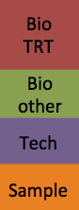
Technical replication
T
Control 1
Control 2
Control 3
TRT 1
TRT 2
TRT 3
within groups
within groups
between groups
Bio
TRT
Compare to declare the significance
Technical replication refers to the sequencing of multiple libraries derived from the same biological sample.
Technical
replicate
Bio
other
Tech
Tech
Sample
Sample
within groups
between groups
False power

Slide 21
Biological replication
T
T
T
Control 1
Control 2
Control 3
TRT 1
TRT 2
TRT 3
within groups
within groups
between groups
Biological replication refers to the sequencing of multiple libraries derived from different biological samples.
Biological
replicate
Bio
TRT
Compare to declare the significance
Technical
replicate
Bio
other
Bio
other
Tech
Tech
Tech
Sample
Sample
Sample
within groups
within groups
between groups
Use biological replication instead of technical replication unless you have your own interest.
More replicates increase the power to detect small treatment effect

Slide 22
Question I
My lab conducted an RNA-Seq experiment to identify the DEs between two biological groups to examine a treatment of great interest. Each group has five biological replicates. I told my graduate student to perform the experiment of each group separately (then I don’t need to worry that the samples from two groups are messed up).
Is this a sound experimental design? Why?
Bio
TRT
Bio
other
Bio
other
Tech
Tech
Sample
Sample
within groups
between groups

Slide 23
Comparison of read counts among different samples
T
T
T
Control 1
Control 2
Control 3
TRT 1
TRT 2
TRT 3
Gene 1 | C1 | C2 | C3 | T1 | T2 | T3
…
Sum | N1 | N2 | N3 | N4 | N5 | N6
Sequence depth (total read number) influences read counts. Therefore, raw read counts can not be compared directly.
Can we generate some comparable numbers among samples?

Slide 24
A normalization method: RPKM and FPKM
RPKM: Read number per kilobase of exons per million of total reads
Control 1
read count = 23
total reads: 15 millions of total reads
RPKM of X = 23 * 1000 / 500 / 15 = 3.1
?
Treatment 1
read count = 18
total reads: 10 millions of total reads
RPKM of X = 18 * 1000 / 500 / 10 = 3.6
?
exon 1 (220 bp)
exon 2 (280 bp)
gene X
FPKM: Fragment number per kilobase per million of total reads.
Fragment = one pair of paired-end reads or one single-end read

Slide 25
More about RPKM
RPKM = 5.1
RPKM = 1.5
gene A
gene B
Can we say that the gene B has higher expression than the gene A?
RPKM is not an ideal indicator to compare the expression/accumulation levels between two genes
amplification bias
alignment efficiency

Slide 26
Experimental Design
Sequencing depth
Increasing sequencing depth decreases sampling variance
Biological replication
Reasonable number of biological replication helps accurately estimate variances to achieve reliable statistical inference.
Randomization and unbiasedness
To avoid confounding effect

Slide 27
Outline
Review of RNA-Seq procedure
Design of DE experiments and results
Experimental design
Multiple test correction
New technologies
Other applications

Slide 28
DE result
 | DE Result
GeneID | Log2FC* | p-value
1 | -0.40 | 0.037
2 | 0.03 | 0.916
3 | -0.89 | 2.42E-05
4 | 0.30 | 0.130
5 | -0.36 | 0.140
6 | -0.07 | 0.811
…
* Log2FC: log2 of fold change (trt / control)

Slide 29
single test vs. multiple tests
Single test:
p = 0.03
At the 5% significant level (P-value threshold = 0.05), we can reject the null hypothesis.
Multiple tests:
p1 = 0.8; p2 = 0.1; p3 = 0.3; p4 = 0.5; ...; p20 = 0.03
At the 5% significant level (P-value threshold = 0.05), we will reject the null hypothesis for p20.
Anything wrong here?

Slide 30
Multiple testing correction
"A p-value is only statistically valid when a single score is computed."
p = 0.05
0
1
p-value when a NULL hypothesis is true

Slide 31
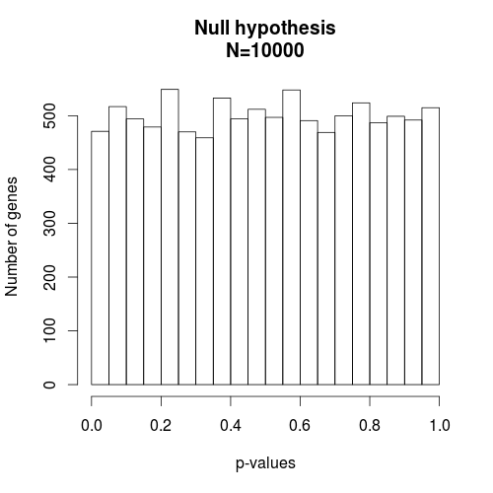
P-value distribution under the null hypothesis (e.g., no treatment effect)
No matter how stringent the criteria are, you’ll identify genes with very small p-values and the false discovery rate (FDR) is 100%.
When the null hypothesis is true, a P-value is distributed uniformly from 0 to 1.

Slide 32
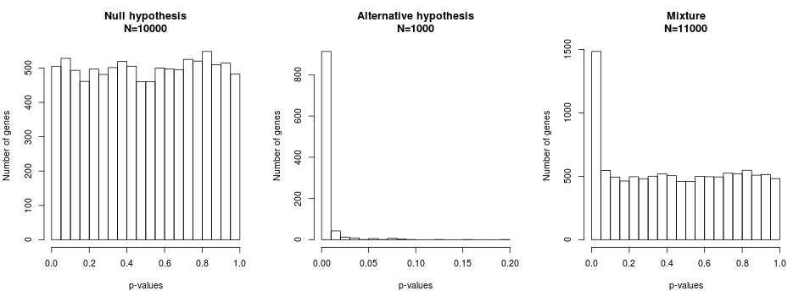
P-value distribution under both the null and non-null hypotheses
When the null hypothesis is true, a P-value is distributed uniformly.
When the null hypothesis is false, the P-value distribution is skewed toward 0.
Cutoff: p=0.05
FDR=471/(471+989)=32%
Cutoff: p=0.01
FDR=102/(102+912)=10%

Slide 33
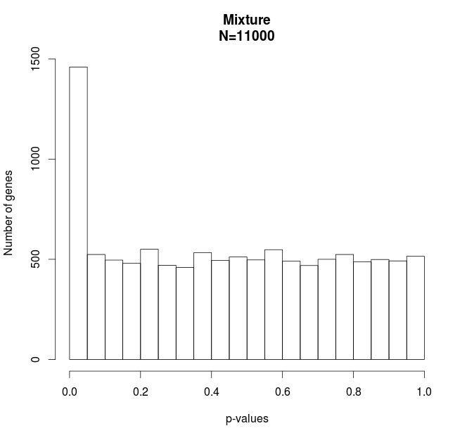
Multiple test correction – FDR method
True positive
P-values < 0.00009
DE=992
False DE=99
FDR 10%
False positive

Slide 34
q-values
The q-value of a test in a set of tests is the smallest FDR for which we can reject the null hypothesis for that one test and all others with smaller p-values.
FDR method (BH) is a method to calculate q-values/adjusted p-values/corrected p-values based on p-values
Gene | p-values | q-values
1 | 0.000 | 0.006
2 | 0.002 | 0.015
3 | 0.009 | 0.059
4 | 0.013 | 0.063
5 | 0.035 | 0.139
6 | 0.051 | 0.171
7 | 0.155 | 0.442
8 | 0.197 | 0.492
9 | 0.247 | 0.539
10 | 0.269 | 0.539
11 | 0.358 | 0.651
12 | 0.396 | 0.656
13 | 0.426 | 0.656
14 | 0.493 | 0.702
15 | 0.526 | 0.702
16 | 0.622 | 0.777
17 | 0.782 | 0.920
18 | 0.862 | 0.958
19 | 0.925 | 0.974
20 | 0.992 | 0.992
5% FDR, q-values < 0.05
10% FDR, q-values < 0.1
20% FDR, q-values < 0.2
Total number of tests: m = 20

Slide 35
Question
If we identify 500 differential expression (DE) genes using the 5% FDR to account for multiple tests. Which one below is a better description?
1. I am 95% confident that 500 genes are DE.
2. The 5% genes (25 genes) in the set are expected to be false DE genes.

Slide 36
False discovery rate (concept)
For example, among 10,000 tests (10,000 genes), 100 significant genes are declared, in which 10 gene is falsely rejected. In this case, the false discovery rate is 10%.
 | True null hypothesis (H₀) | False null hypothesis (H₁) | Total
Rejected (Declared significance) | 10 | 90 | 100

Slide 37
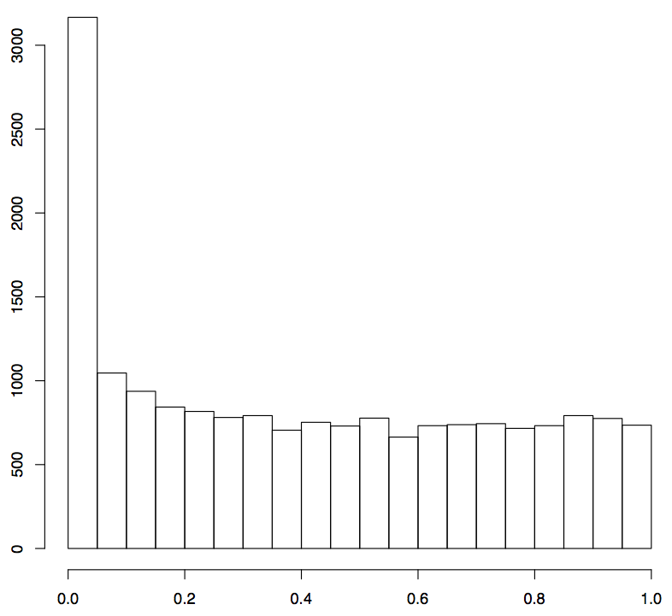
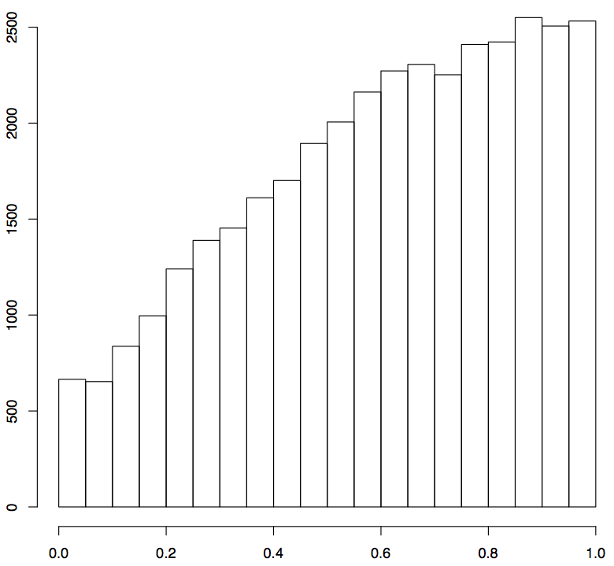
P-value histograms from real studies
1
2
Number of genes
p-values
p-values
If you perform an RNA-Seq experiment, which one would you hope to obtain? Why?

Slide 38
P-value histograms from real studies
1
2
Number of genes
p-values
p-values
DE = 1,370, FDR=5%
DE = 0, FDR=20%

Slide 39
Keywords
total RNA
mRNA
randomization, replication, RNA quality
DNA library
short or long reads
single- or paired-end reads, read length
sequencing depths
(e.g., >20 million short reads for most experiments)
sequencing
reads
alignment
intron-spanning Aligner (e.g., GSNAP, STAR)
read counts
statistical test
count data statistical analysis (DESeq2 & edgeR)
multiple test p-value adjustment
q-values
significance

Slide 40
Outline
Review of RNA-Seq procedure
Design of DE experiments and results
Experimental design
Multiple test correction
New technologies
Other applications

Slide 41
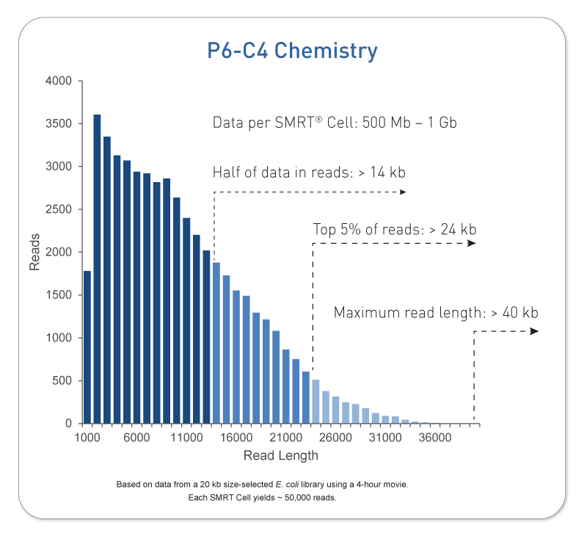
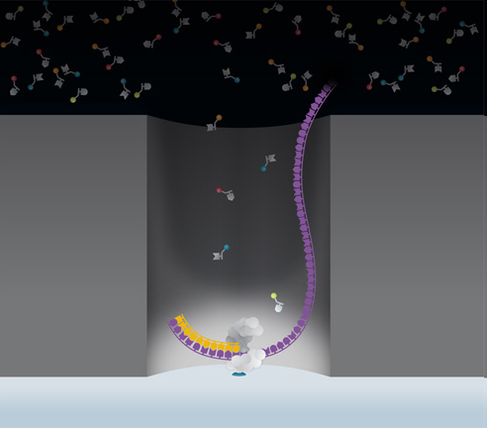
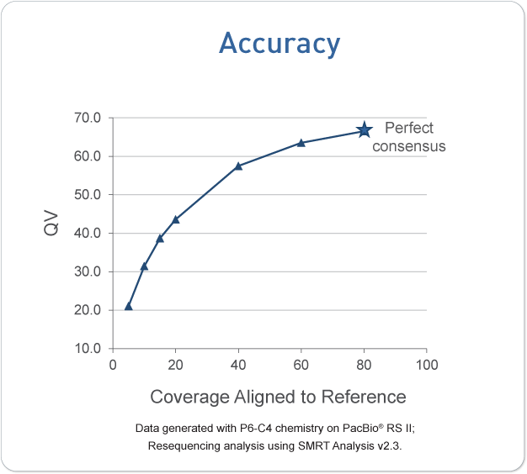
PacBio – Single Molecule Real Time (SMRT)
PacBio tech video
Single molecule sequencing
no amplifications required
up to 70+ kbp sequencing
Moderate sequencing throughput
high sequencing error rate (~15%, random, no-context-specific errors)
pacbio.com

Slide 42
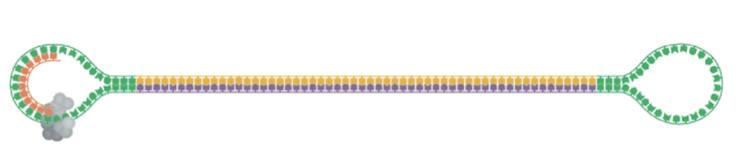
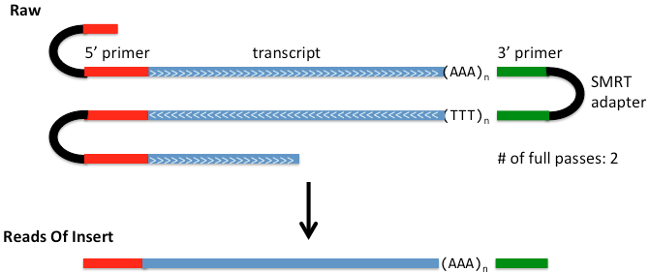
PacBio long reads for RNA sequencing (Iso-Seq)
High-quality, single-molecule, circular-consensus (CCS)
Multiple passes improve sequence quality
https://github.com/PacificBiosciences/cDNA_primer/wiki/Understanding-PacBio-transcriptome-data

Slide 43
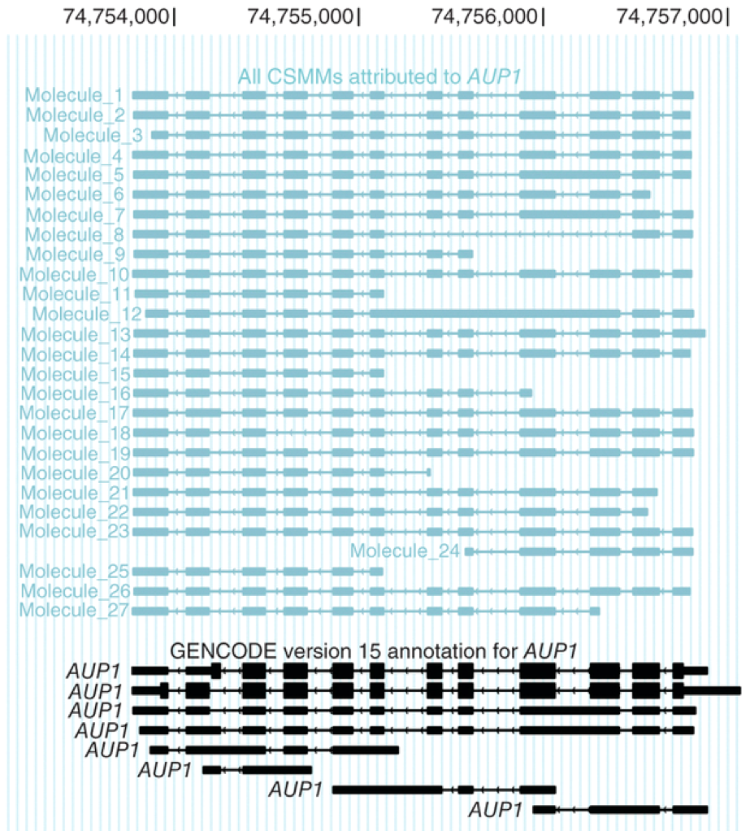
Long reads to sequence full-length cDNA
The majority of reads represent all splice sites of original transcripts
Isoforms can be monitored at a single-molecule level without amplification or fragmentation
Sharon et al. Nature Biotechnology 31, 1009–1014 (2013)

Slide 44
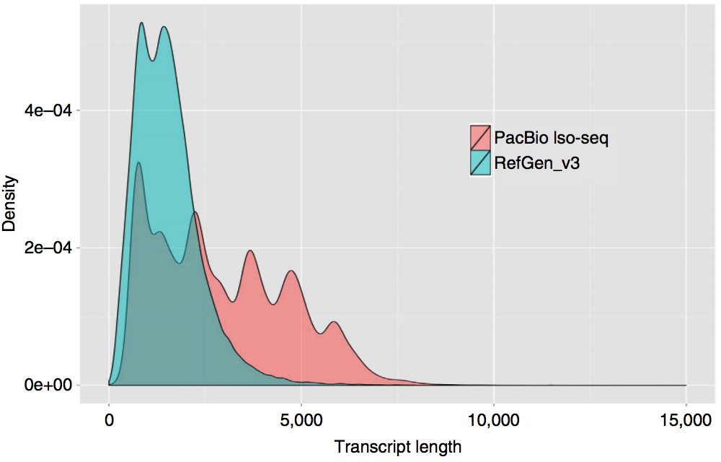
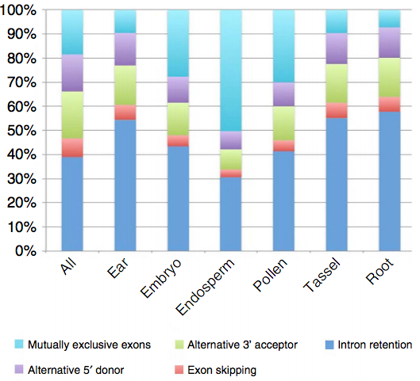
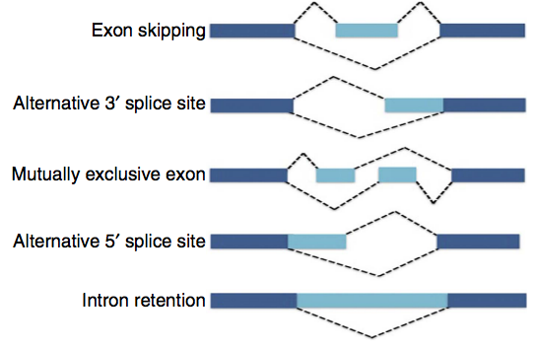
maize – Iso-Seq
Wang et al., Nature Communications, 2016, 7:11708

Slide 45

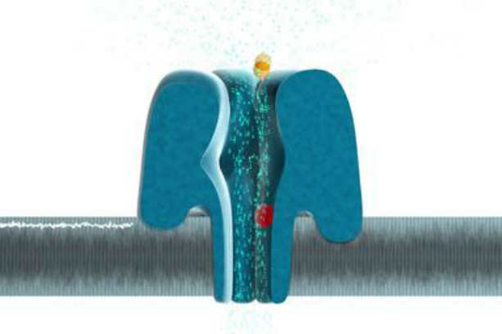
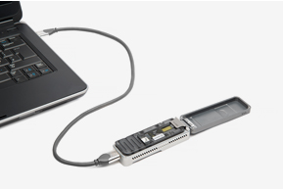
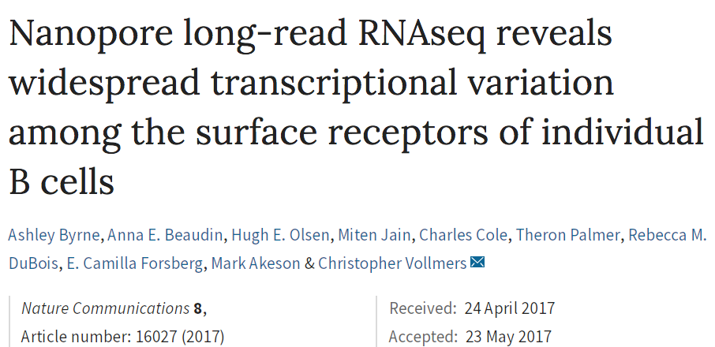
Oxford Nanopore A promising technology
Single molecular sequencing
No amplifications
Long reads (up to hundreds of kb)
Error rate is high (~10-30%)
MinION
USB disposable sequencer
Hundreds of Mb in several hours
As each nucleobase passes through the pore the current is affected and this change allows sequence to be read out.
nanoporetech.com

Slide 46
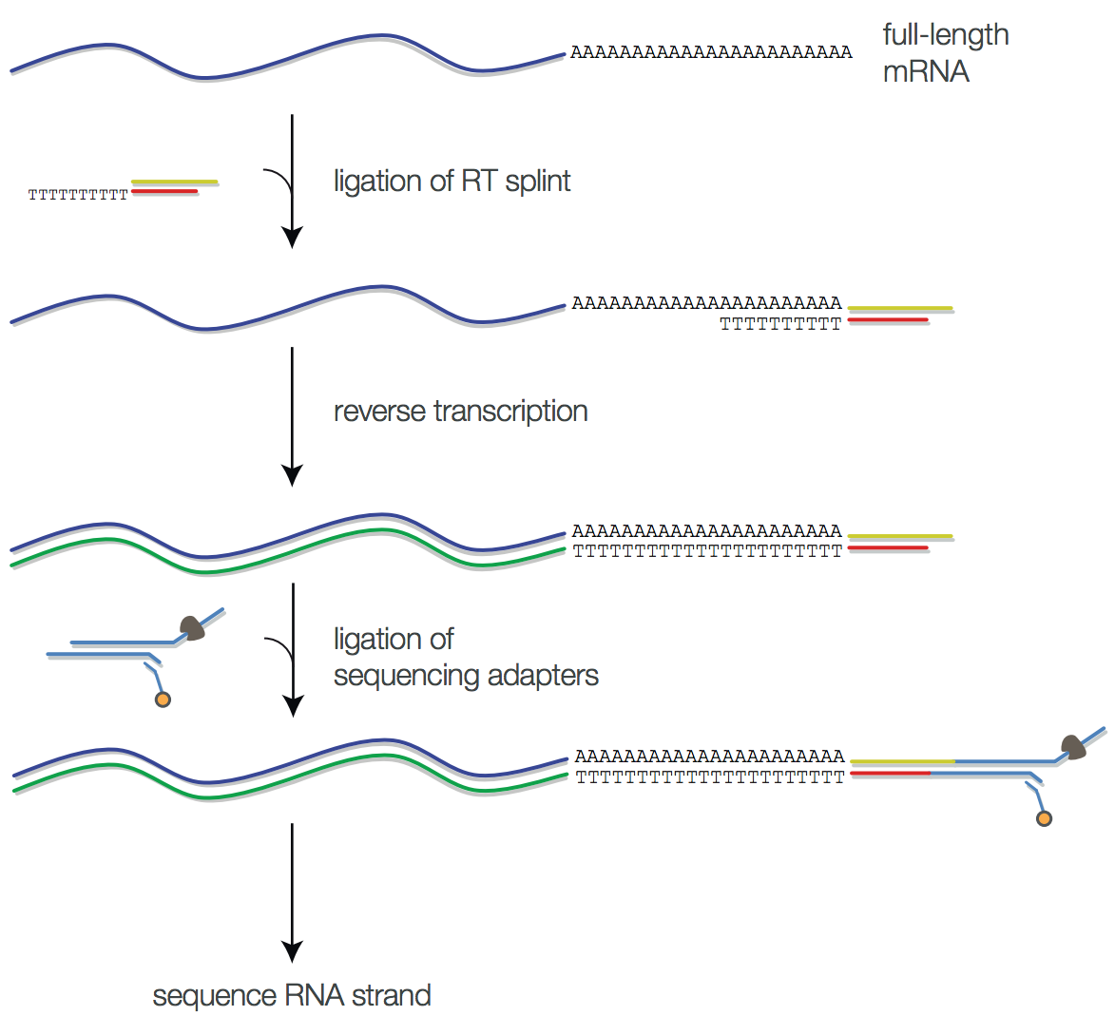
Nanopore – direct RNA sequencing
http://biorxiv.org/content/early/2016/08/12/068809
Garalde et al., Highly parallel direct RNA sequencing on an array of nanopores, 2018, Nature Methods 15:201–206

Slide 47
High errors associated with single molecule sequencing
Nanopore
(InDel)
High error! Multiple reads for self-correction.
PacBio
(InDel)
Roche 454
(InDel)
Ion Torrent
(InDel)
Illumina
(substitution)
Sanger
HIGH
LOW
Sequencing Error

Slide 48
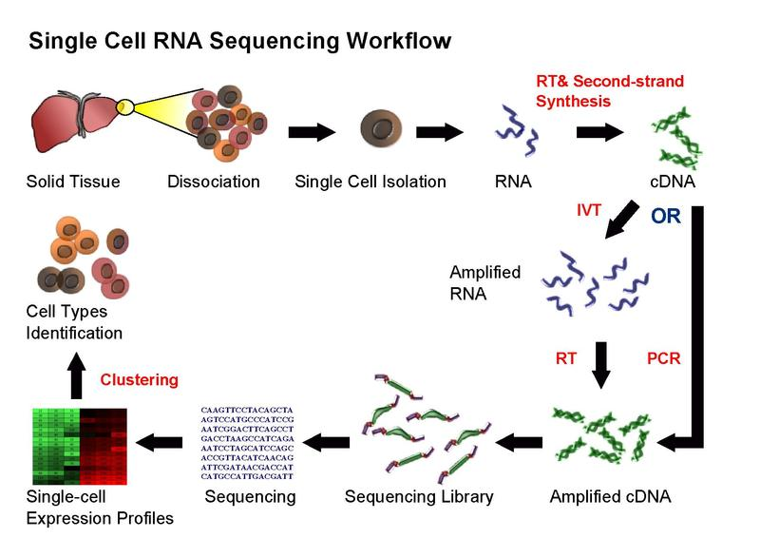
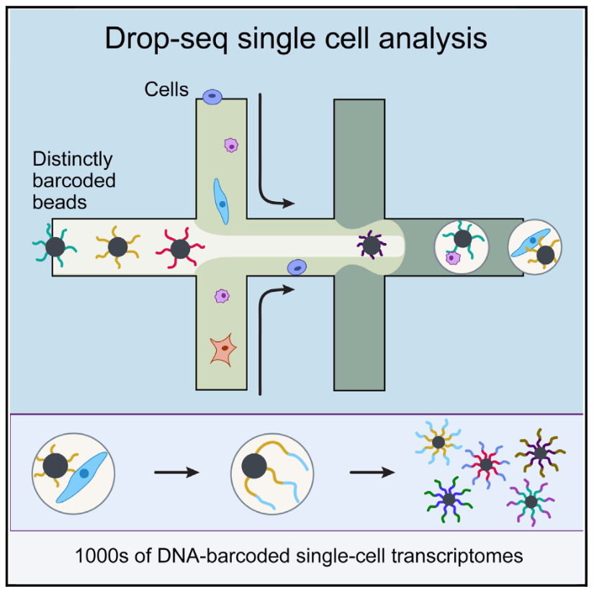
single-cell RNA-Seq (scRNA-Seq)
wikipedia
Macosko et al., Cell, 2015
IVT: in vitro transcription
RT: reverse transcription

Slide 49
Outline
Review of RNA-Seq procedure
Design of DE experiments and results
Experimental design
Multiple test correction
New technologies
Other applications (an example)

Slide 50
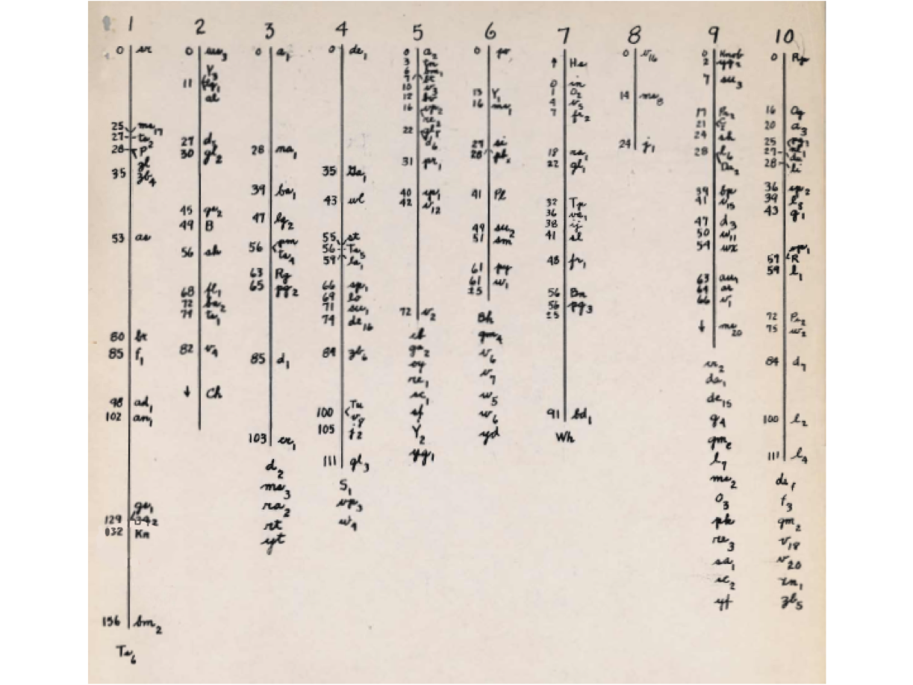
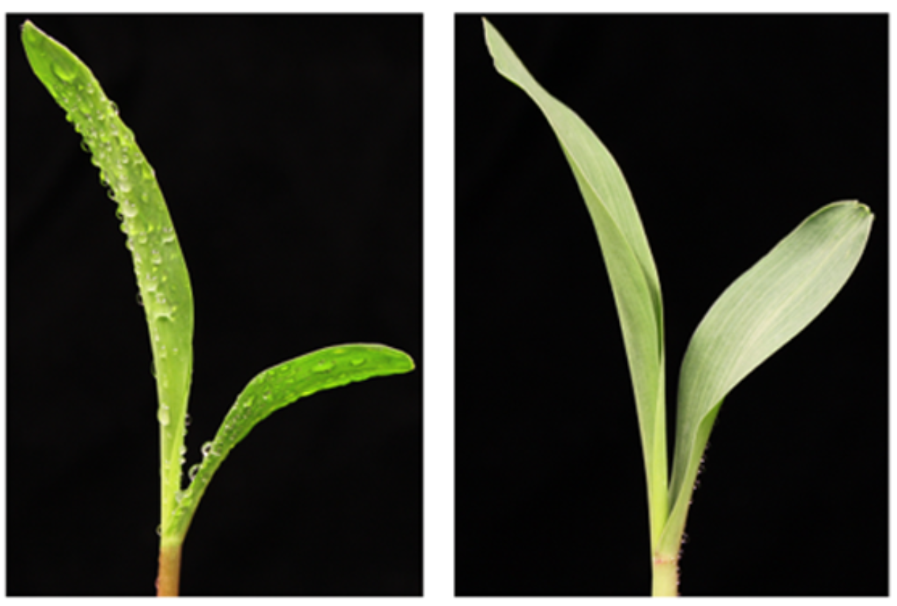
BSR-Seq, an RNA-Seq based approach for genetic mapping of a mutant gene
gl3 mutant
gl3 wt
An early maize genetic map (1937)
– image from maizeGDB.org

Slide 51
Example of a mutant mapping using BSA
Green chr
Red chr
⊗
Heterozygous mutant:
Recessive mutant
F₂
Mutant pool
1 : 3
Non-mutant pool
Genetic
Marker
. . .
. . .
Red:Green
The ratio of Red:Green is proportional to the genetic distance between the mutant gene and the genetic marker.

Slide 52
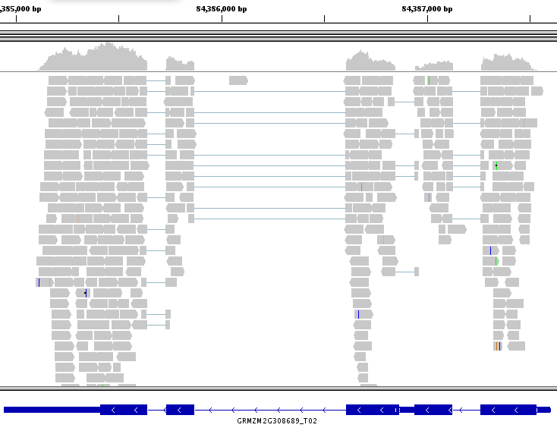
RNA-Seq
RNA-Seq generated ~13 millions of reads per sample
64,852 SNPs were identified and quantified in both the mutant pool and the non-mutant pool

Slide 53
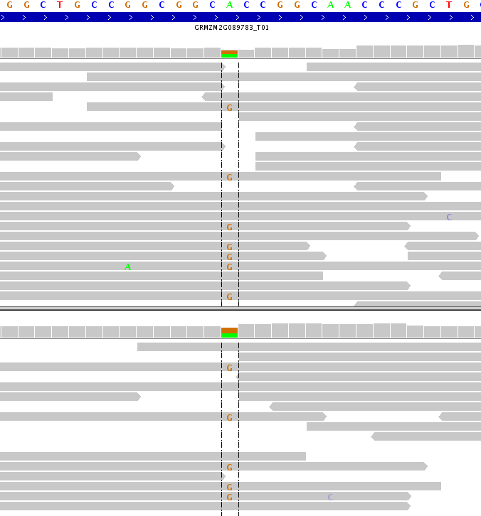
Example of a SNP UNLINKED to a mutant gene
Reference
A
A
Reads from Mutants
A:G = 8:7
A
A
A
A
A
A
A
Reads from non-mutants
A
A:G = 4:5
A
A

Slide 54
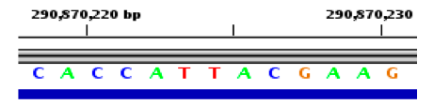
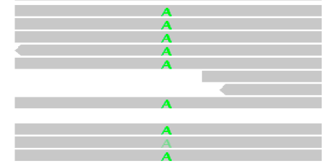

Example of a SNP Completely LINKED to a mutant gene
Mutants
Reference
Non-mutants
Reads from Mutants
T:A =0:9
Reads from non-mutants
T:A = 5:2
A Bayesian approach was developed to calculate the probability of complete linkage between the SNP site and the mutant gene.

Slide 55
BSR-Seq mapping result
each dot: a SNP
chr4
*
* Probability of complete linkage between the SNP and the gl3 gene

Slide 56
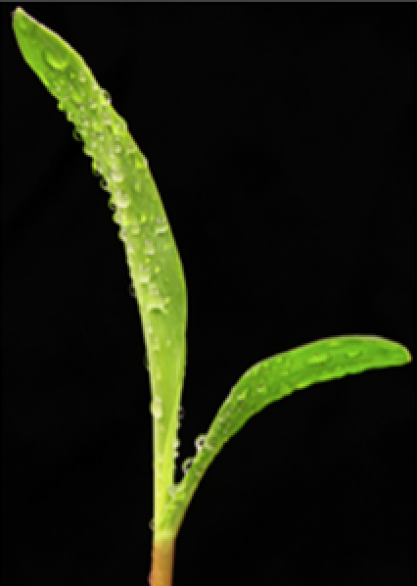
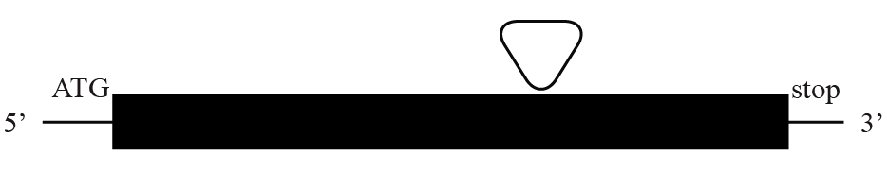
gl3 cloning
Down-regulated
Partially expressed
GRMZM2G162434, an R2R3 type myb transcription factor

Slide 57
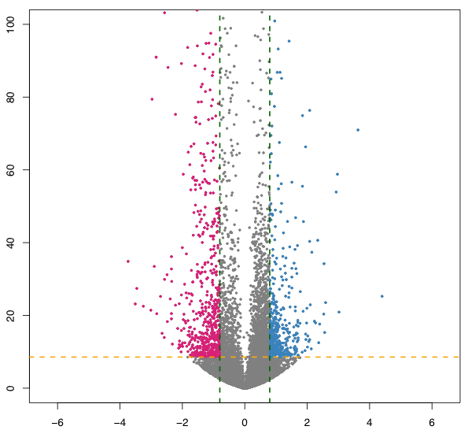
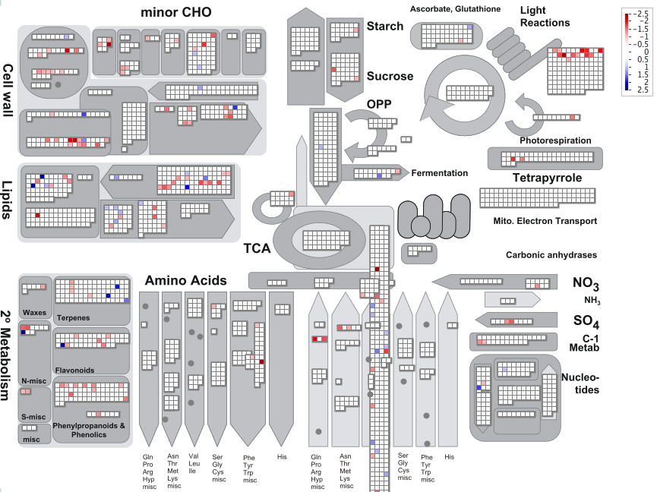
Differential expression analysis of gl3 using the SAME RNA-Seq data used for BSR-Seq
-log10(p-values)
Log2(WT/Mut)
MapMan view
1,095 genes with significantly differential expression

Slide 58
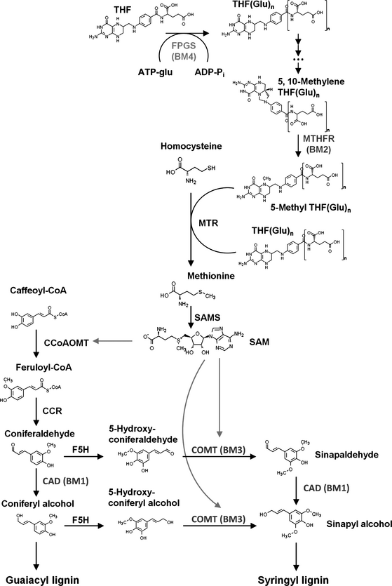
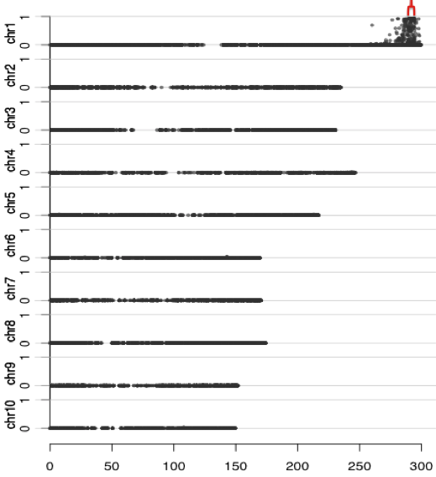
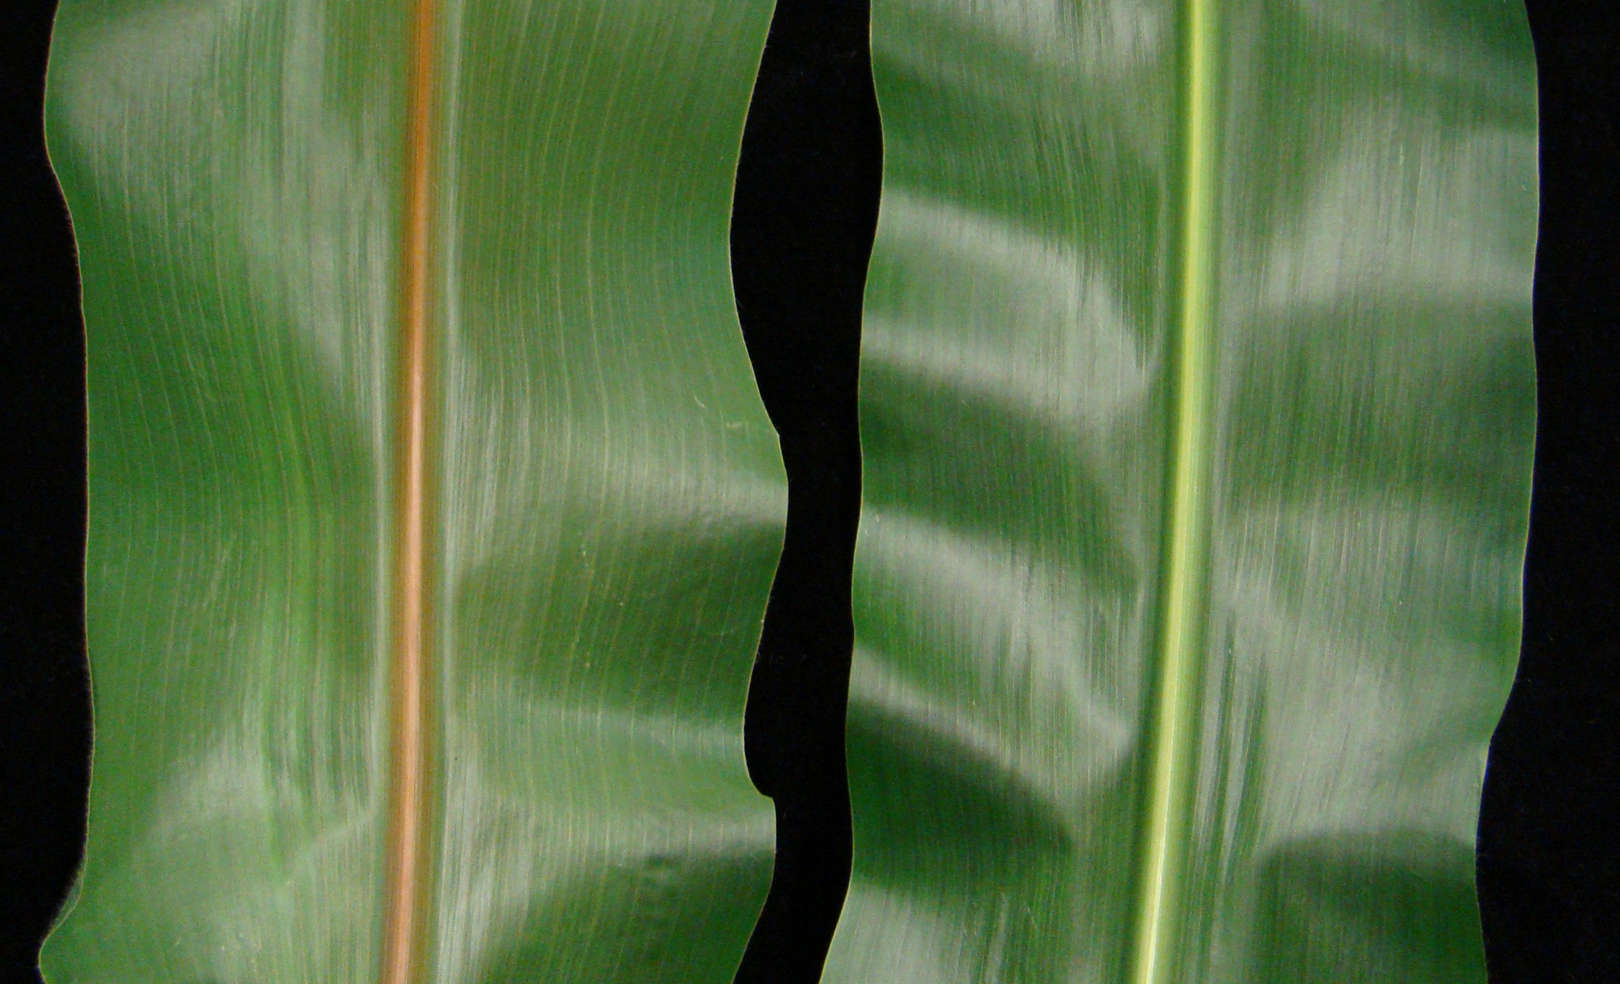
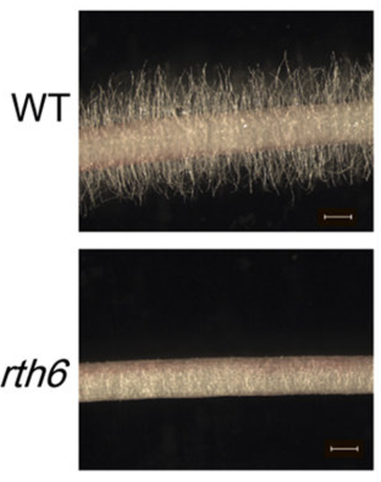
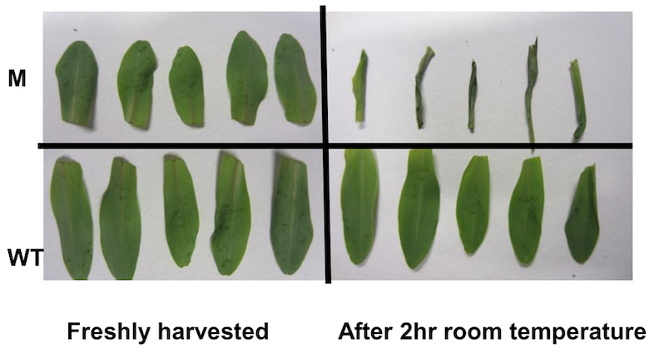
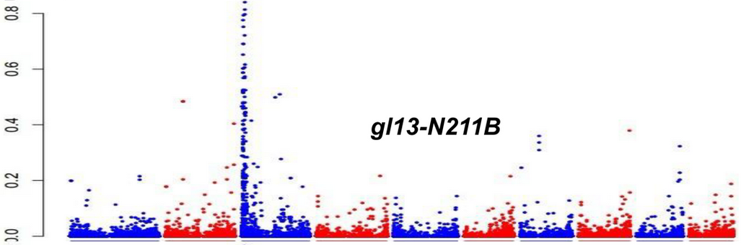
Other successful cases in maize with BSR-Seq
Bm4
Bm2
1. cloning of lignin related genes (bm2 and bm4)
- Tang et al. Plant J., 2: 380–392 (2013)
- Li et al. Plant J., 81: 493-504 (2015)
2. cloning of another glossy gene and and a root hairless gene (gl13, rth6)
- Li et al. PLoS One, 8: e82333 (2013)
- Li et al. Sci Rep, srep34395 (2016)
Physical Position (Mb)

Slide 59
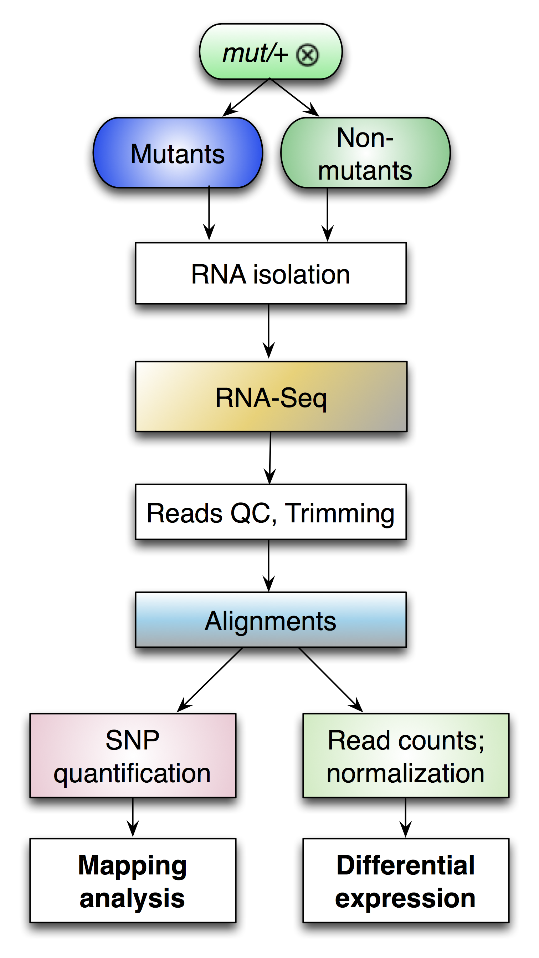
Summary (BSR-Seq)
Define genetic markers
Map the causal gene or identify trait-associated genetic markers
Genome-wide gene expression
Liu, S et al., 2012 PLoS ONE, 7(5): e36406.

Slide 60
Summary
Randomization of experimental units is needed and each sample requires certain sequencing depth.
Biological replication rather than technical replication is typically needed for an RNA-Seq experiment.
P-values need to be corrected to account for multiple tests. The FDR method is a reliable approach for the correction.
Many bioinformatics pipelines and statistical methods have been developed. Methods and parameters need to be carefully selected.

Slide 61
Selected references
Benjamini Y, Hochberg Y. (FDR co-authors). 1995. Controlling the False Discovery Rate - a Practical and Powerful Approach to Multiple Testing. Journal of the Royal Statistical Society Series B-Methodological 57:289-300.
Conesa A, Madrigal P, Tarazona S, Gomez-Cabrero D, Cervera A, McPherson A, Szczesniak MW, Gaffney DJ, Elo LL, Zhang X, et al. 2016. A survey of best practices for RNA-seq data analysis. Genome Biol 17:13.
Liu S, Yeh CT, Tang HM, Nettleton D, Schnable PS. 2012. Gene mapping via bulked segregant RNA-Seq (BSR-Seq). PLoS One 7:e36406.
Love MI, Huber W, Anders S. (DeSeq2 co-authors). 2014. Moderated estimation of fold change and dispersion for RNA-seq data with DESeq2. Genome Biol 15:550.
Macosko EZ, Basu A, Satija R, Nemesh J, Shekhar K, Goldman M, Tirosh I, Bialas AR, Kamitaki N, Martersteck EM, et al. 2015. Highly Parallel Genome-wide Expression Profiling of Individual Cells Using Nanoliter Droplets. Cell 161:1202-1214.
Robinson MD, McCarthy DJ, Smyth GK. 2010. edgeR: a Bioconductor package for differential expression analysis of digital gene expression data. Bioinformatics 26:139-140.
Wang B, Tseng E, Regulski M, Clark TA, Hon T, Jiao Y, Lu Z, Olson A, Stein JC, Ware D. 2016. Unveiling the complexity of the maize transcriptome by single-molecule long-read sequencing. Nat Commun 7:11708.

